Slide 1
Test plan discussion
Toaster 烤炉with FM radio receiver

Slide 2
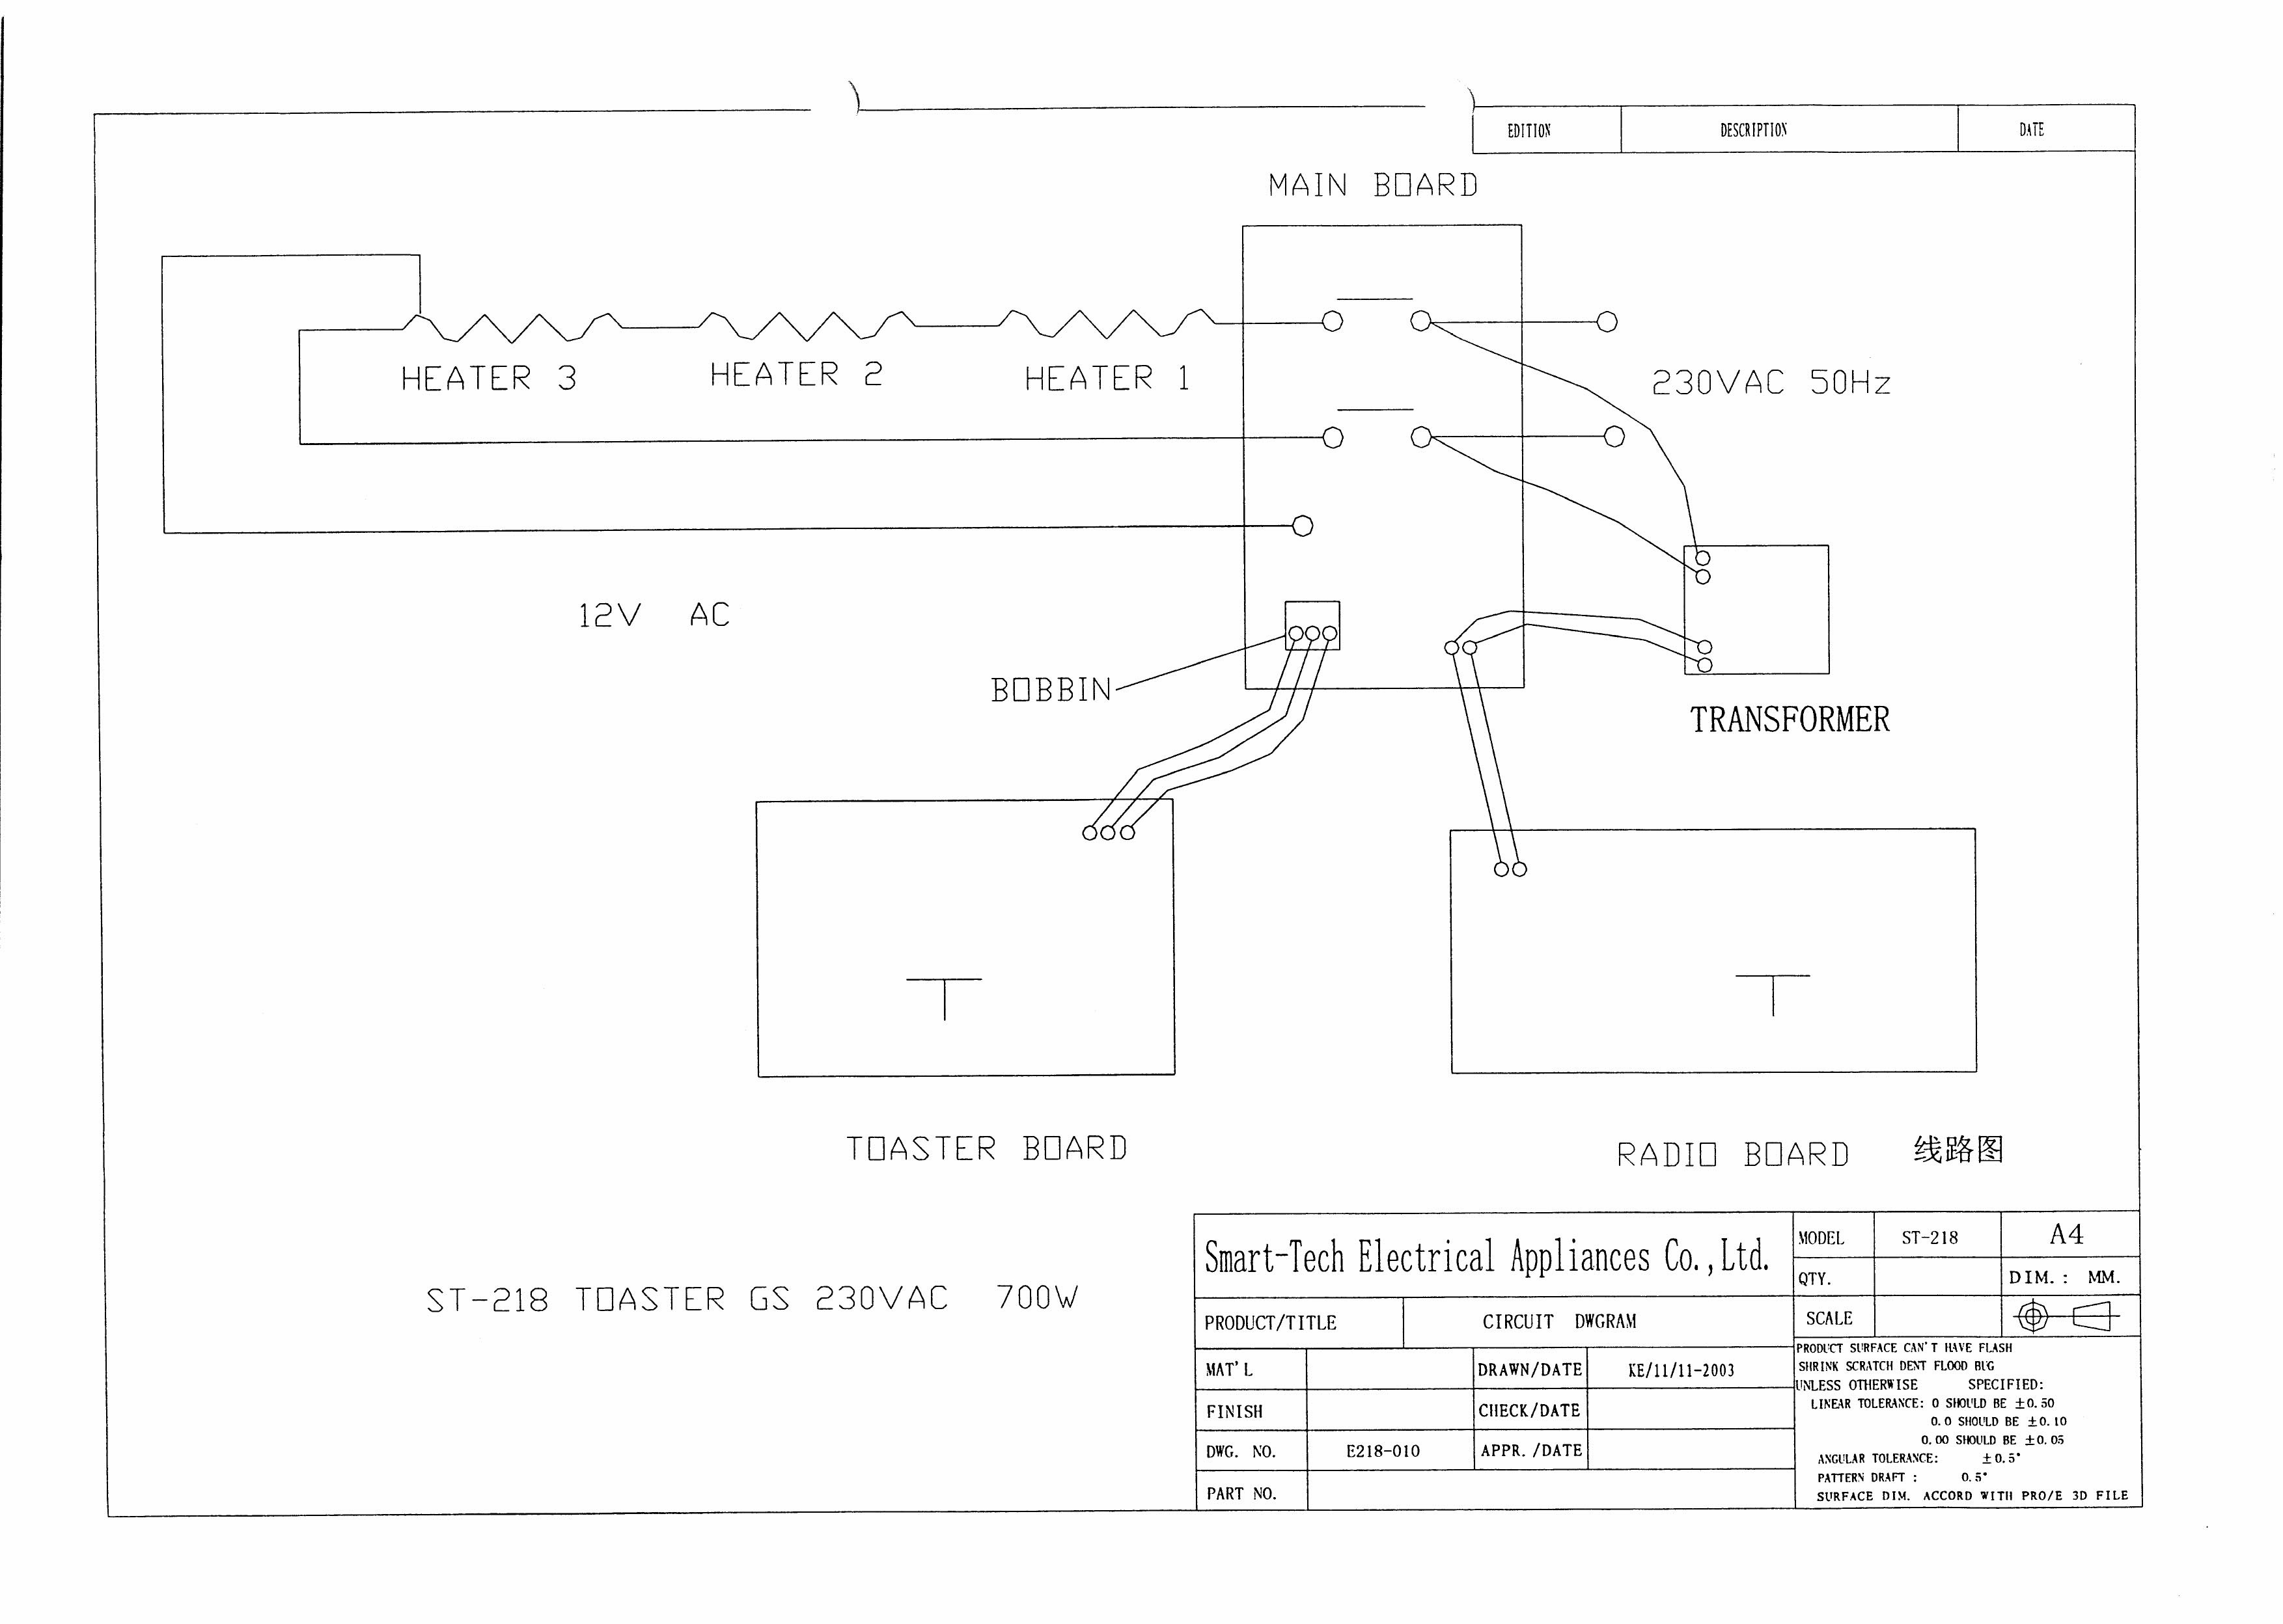
Circuit Diagram

Slide 3
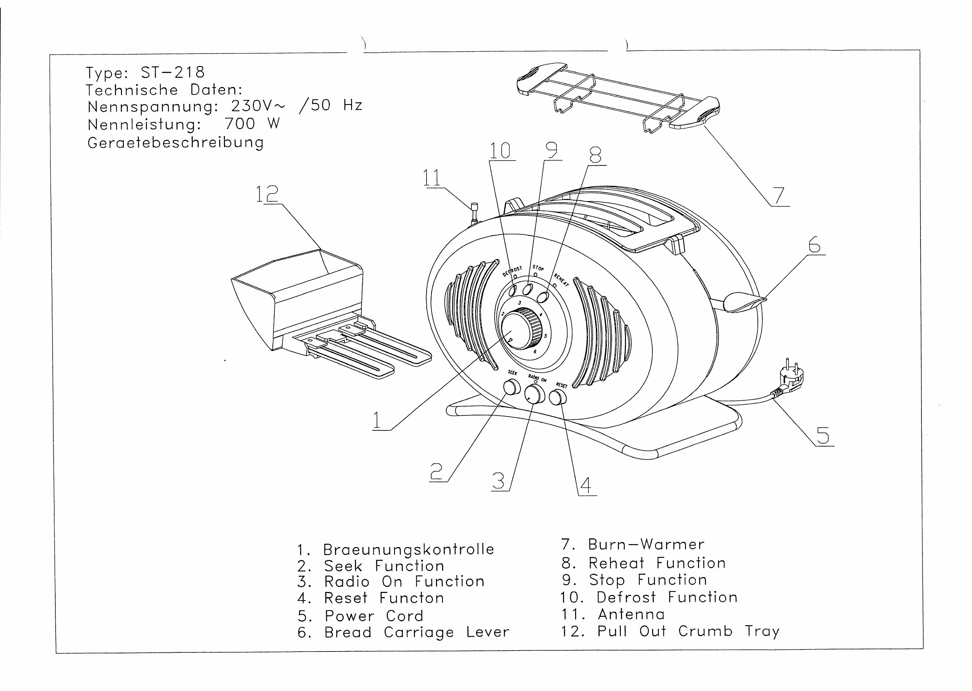
Additional information- construction drawing

Slide 4
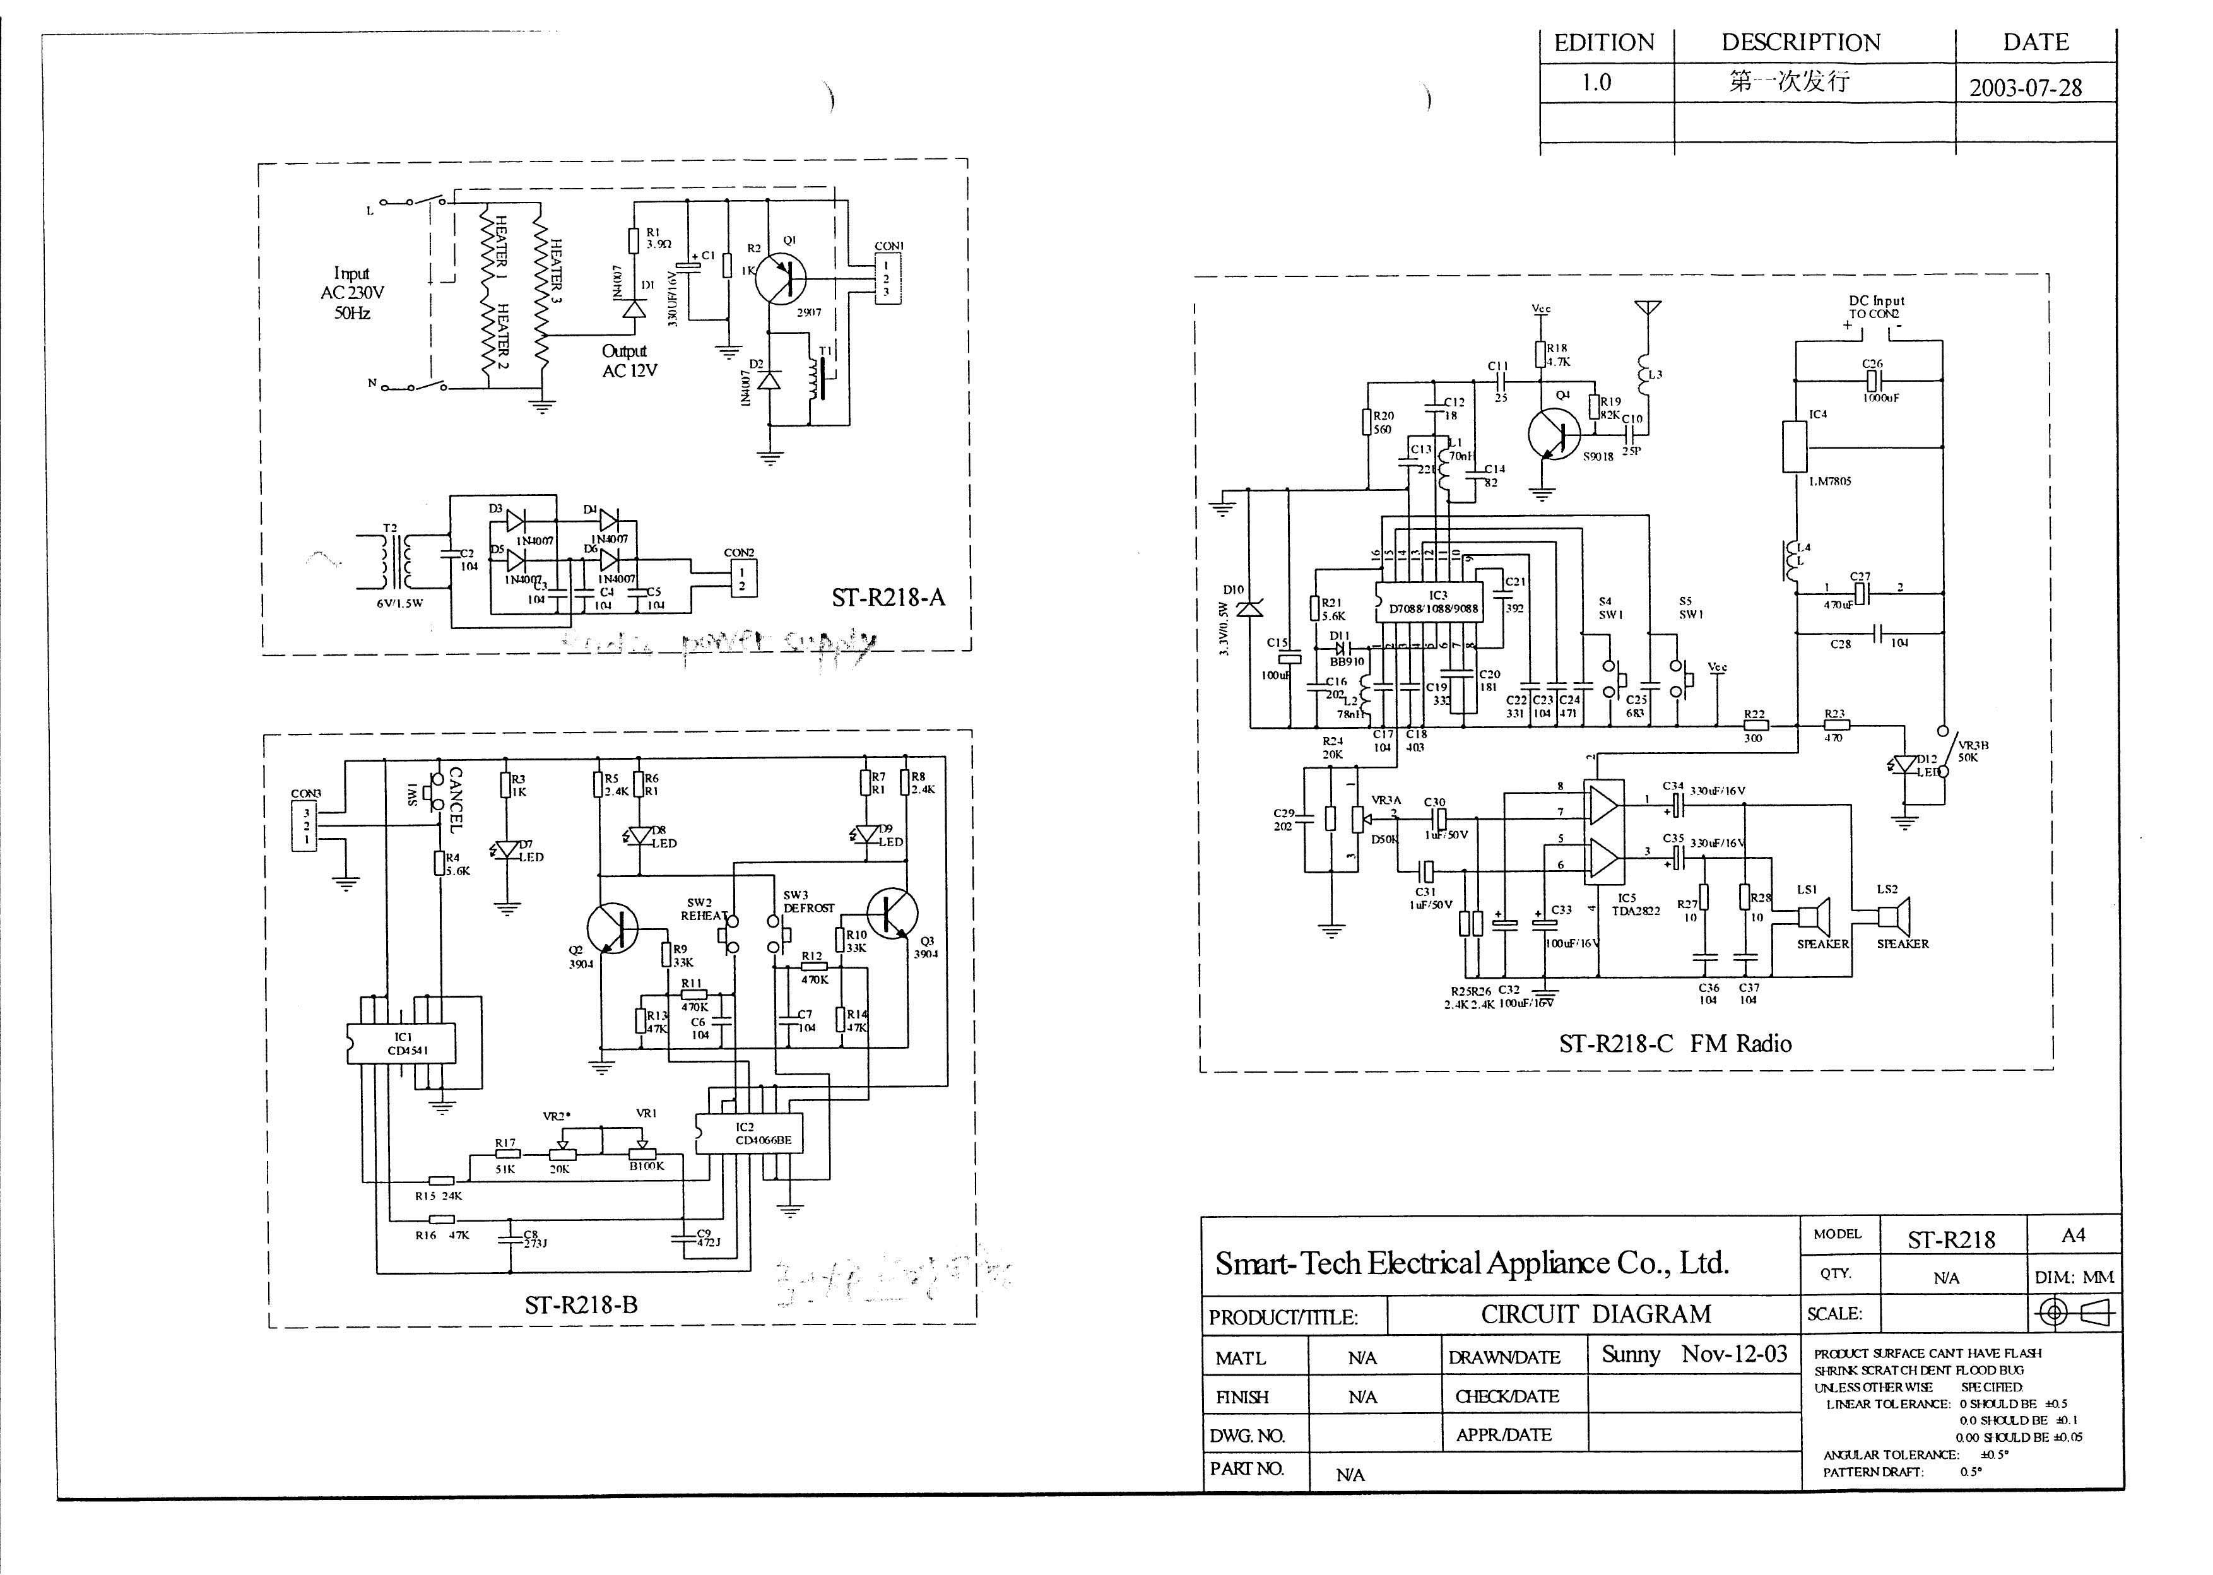
Circuit diagram

Slide 5
Disturbance Source
Local oscillator for FM receiver
Control IC for toaster
AMP IC (not major)

Slide 6
Sensitive components for immunity test
FM radio IC
Toaster control IC

Slide 7
Applicable standards
Nominal household appliance + FM receiver
EN 55014-1
EN 55013
EN 55014-2
EN 55020 (no requirement as FM radio)
EN 61000-3-2
EN 61000-3-3

Slide 8
Test items/operation modes
Disturbance voltage
  Toasting for EN 55014-1 limit
  FM Radio receiving for EN 55013 limit, mid freq. of the receiving band would be sufficient enough
  (In order to cover 14-1 & 13, toasting with receiving and 13 limit can be used for judge of compliance. But we can’t prove for failure with this measurement)
Disturbance power
  Toasting for EN 55014 limit
Radiated Emission
  FM receiving, better 3 freq. --- high, mid, low of the range
Click
  For toasting function only (according to general toaster test setup)

Slide 9
Test items/operation modes
Harmonics
  Toasting (and FM receiving for complete measurement)
Flicker
  Same as harmonics
ESD
  Toasting and FM
EFT
  Same as ESD
CS
  Toasting
Surge
  Same as ESD
Dips
  Same as ESD

